Slide 1
Javascript Basics

Slide 2
JavaScript Comment
The JavaScript comments are meaningful way to deliver message. It is used to add information about the code, warnings or suggestions so that end user can easily interpret the code.
The JavaScript comment is ignored by the JavaScript engine i.e. embedded in the browser.
Advantages of JavaScript comments
To make code easy to understand It can be used to elaborate the code so that end user can easily understand the code.
To avoid the unnecessary code It can also be used to avoid the code being executed. Sometimes, we add the code to perform some action. But after sometime, there may be need to disable the code. In such case, it is better to use comments.

Slide 3
Types of JavaScript Comments
Single-line Comment
Multi-line Comment
JavaScript Single line Comment
It is represented by double forward slashes (//). It can be used before and after the statement.
Let’s see the example of single-line comment i.e. added before the statement.
<script>
// It is single line comment
document.write("hello javascript");
</script>

Slide 4
JavaScript Multi line Comment
It can be used to add single as well as multi line comments. So, it is more convenient.
It is represented by forward slash with asterisk then asterisk with forward slash. For example:
<script>
/* It is multi line comment.
It will not be displayed */
document.write("example of javascript multiline comment");
</script>

Slide 5
JavaScript Variable
A JavaScript variable is simply a name of storage location. There are two types of variables in JavaScript : local variable and global variable.
There are some rules while declaring a JavaScript variable (also known as identifiers).
Name must start with a letter (a to z or A to Z), underscore( _ ), or dollar( $ ) sign.
After first letter we can use digits (0 to 9), for example value1.
JavaScript variables are case sensitive, for example x and X are different variables.

Slide 6
Example of JavaScript variable
<script>
var x = 10;
var y = 20;
var z=x+y;
document.write(z);
</script>

Slide 7
JavaScript local variable
A JavaScript local variable is declared inside block or function. It is accessible within the function or block only. For example:
<script>
function abc(){
var x=10;//local variable
}
</script>
JavaScript global variable
A JavaScript global variable is accessible from any function. A variable i.e. declared outside the function or declared with window object is known as global variable. For example:

Slide 8
<script>
var data=200;//gloabal variable
function a(){
document.writeln(data);
}
function b(){
document.writeln(data);
}
a();//calling JavaScript function
b();
</script>

Slide 9
Javascript Data Types
JavaScript provides different data types to hold different types of values. There are two types of data types in JavaScript.
Primitive data type
Non-primitive (reference) data type
JavaScript is a dynamic type language, means you don't need to specify type of the variable because it is dynamically used by JavaScript engine. You need to use var here to specify the data type. It can hold any type of values such as numbers, strings etc. For example:

Slide 10
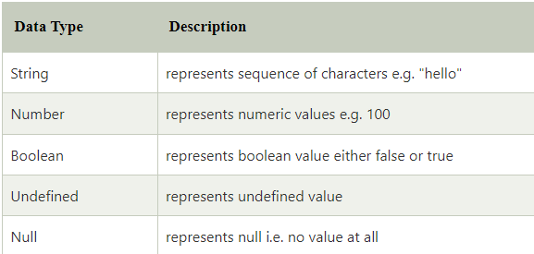
var a=40;//holding number
var b="Rahul";//holding string
JavaScript primitive data types
There are five types of primitive data types in JavaScript. They are as follows:

Slide 11
// Numbers:
let length = 16;
let weight = 7.5;
// Strings:
let color = "Yellow";
let lastName = "Johnson";
// Booleans
let x = true;
let y = false;

Slide 12
JavaScript non-primitive data types
The non-primitive data types are as follows:
1. An object
2. An array
3. A date
// Object:
const person = {firstName:"John", lastName:"Doe"};
// Array object:
const cars = ["Saab", "Volvo", "BMW"];
// Date object:
const date = new Date("2022-03-25");

Slide 13
Object
<body>
<h2>JavaScript Objects</h2>
<p id="demo"></p>
<script>
const person = {
firstName : "John",
lastName : "Doe",
age : 50,
eyeColor : "blue"
};
document.getElementById("demo").innerHTML =
person.firstName + " is " + person.age + " years old.";
</script>
</body>

Slide 14
Array
<body>
<h2>JavaScript Arrays</h2>
<p>Array indexes are zero-based, which means the first item is [0].</p>
<p id="demo"></p>
<script>
const cars = ["Saab","Volvo","BMW"];
document.getElementById("demo").innerHTML = cars[0];
</script>
</body>

Slide 15
Date
<body>
<h2>JavaScript Arrays</h2>
<p>Array indexes are zero-based, which means the first item is [0].</p>
<p id="demo"></p>
<script>
const date = new Date("2022-03-25");
document.getElementById("demo").innerHTML = date;
</script>
</body>

